Slide 1
Computer Simulation and Modeling
Modeling Techniques

Slide 2
What is Data Model?
A data model is a visual representation of data elements and the relations between them.
It defines the logical structure of data, how they are connected and how the data are processed and stored in information systems.
It provides the conceptual tools for describing the model of an information system at the data abstraction level.
It also provides a portrait of the final system, and how it will look after implementation.

Slide 3
Types of Data Model
There are mainly three different types of data models –
Conceptual Data Model: This Data Model defines WHAT the system contains.
Logical Data Model: Defines HOW the system should be designed.
Physical Data Model: This Data Model describes HOW the system will be implemented using a specific DBMS system.

Slide 4
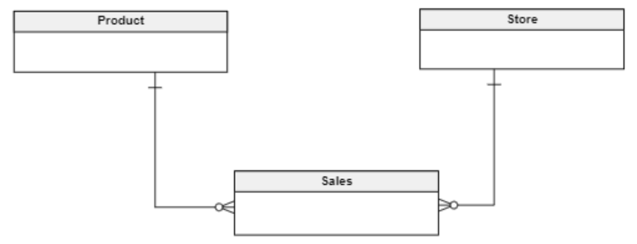
Conceptual Data Model
It is an organized view of database concepts and their relationships.
The purpose of creating a conceptual data model is to establish entities, their attributes, and relationships.
In this data modeling level, there is hardly any detail available on the actual database structure.

Slide 5
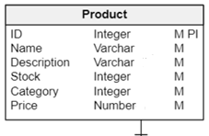
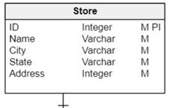
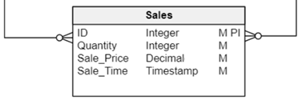
Logical Data Model
It expands the conceptual data model.
It adds more information about the attributes of each entity.
Software developers, as well as administrators, tend to work at this level.
Although the data can be described as data records that are stored in the form of data structures, the data structure implementation and other internal details are hidden at this level.

Slide 6
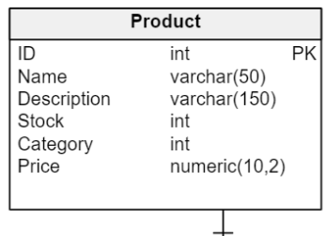
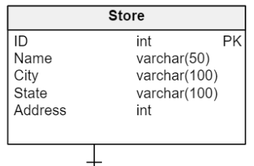
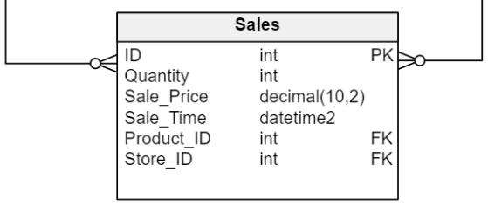
Physical Data Model
The physical model is very similar to the logical one but with more details about the attributes of each entity.
The entities become tables, and the attributes become columns for the database.
Analysts can use a physical schema to calculate storage estimates, and this may include specific storage allocation details for an information system.

Slide 7
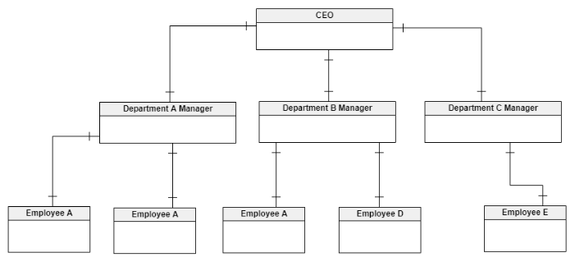
Data Modeling Techniques Hierarchical Technique
It is optimized for hierarchical data i.e. it looks like a tree structure.
The data is stored in parent and child records, each of which may have a set of attributes. Parent may have more than one child but child must have one parent.
It was a popular concept in a wide variety of fields, including computer science, mathematics, design, architecture, systematic biology, philosophy, and social sciences.
But it is rarely used now due to
the difficulties of retrieving and
accessing data.

Slide 8
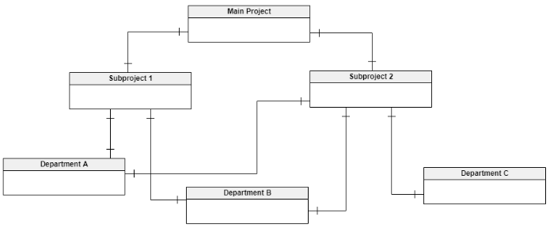
Data Modeling Techniques Network Technique
It provides a flexible way to represent the objects and the relationships among them.
A key characteristic of this data model is that its object types are nodes and the relationships form arcs in the graph when the schema is viewed as a graph.
This is similar to the hierarchical model; however, the network model does not constrain its arcs to form a hierarchy.

Slide 9
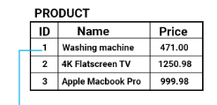
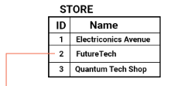
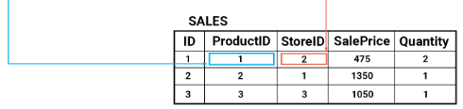
Data Modeling Techniques Relational Technique
The relational data model has become the most widely used data model.
Its key characteristic is that data is stored in tables and columns. Each table contains information relevant to a single logical entity.
It has four different sets of relations between the entities: one to one, one to many, many to one, and many to many.

Slide 10
Data Modeling Techniques Entity-relationship Technique
The entity-relationship data model is a variation of the relational model and is widely adopted in enterprise applications built on top of a relational model.
It has minimal redundancy among its entities and clearly defined relationships.
Most modern applications are built on an entity-relationship technique.

Slide 11
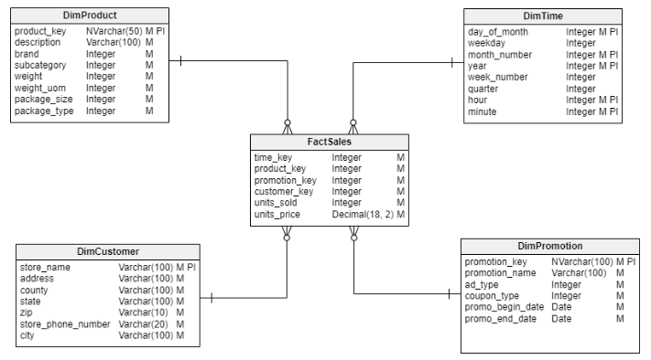
Data Modeling Techniques Dimensional Technique
It has only two main categories of attributes for an entity or table: facts and dimensions.
The fact attributes are measurements of a certain activity represented by a dimension.
The dimension attributes are in
tables containing the definition
of the business item measured
by the fact.
It’s often called the star schema,
with a fact table connected to
multiple dimensions.

